Slide 1
Indo-Pacific Dynamics: Power Shifts and Regional Cooperation
Examining the geopolitical landscape of the Indo-Pacific as new global and regional actors engage in cooperative and competitive dynamics

Slide 2
Actors in the Indo-Pacific
The United States remains a formidable global power, wielding significant influence in the region.
Japan, with its robust economy, is a key player.
India, as a rising power, is increasingly asserting its presence.
Australia serves as a linchpin, connecting the various nations.
China's economic success is heavily dependent on access to markets like the United States, Japan, and the European Union. The critical question is: how can China maintain its interests in the region without jeopardizing its global trade strategy?

Slide 3
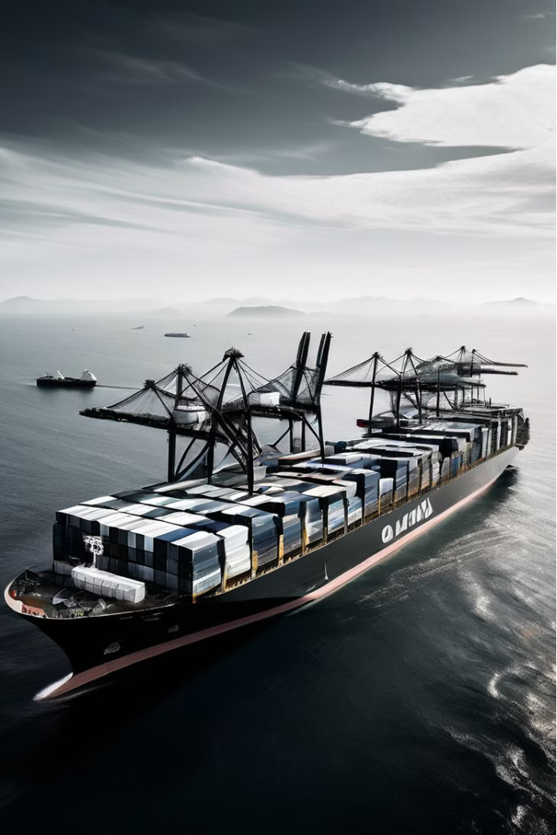
The Indo-Pacific region has become a hotbed of geopolitical activity, with a complex web of multilateral and minilateral cooperation shaping the dynamics of power and influence.

Slide 4
Minilateralism in the Malacca Strait
1
Malacca Strait Patrol (MSP)
The Malacca Strait Patrol, involving Indonesia, Thailand, Malaysia, and Singapore, has been successful in mitigating the threat of piracy in this critical maritime chokepoint. This minilateral cooperation has enhanced regional security and stability.
2
Quad's Maritime Security Cooperation
The Quadrilateral Security Dialogue (Quad), comprising Australia, the US, Japan, and India, has a vested interest in safeguarding the Malacca Strait from threats such as piracy, terrorism, and geopolitical tensions. The Quad emphasizes the importance of freedom of navigation and overflight in the Indo-Pacific.
3
Competing Visions: Quad vs. China's MSR
The rivalry between the Quad and China's Maritime Silk Road (MSR) initiative is a significant aspect of the strategic competition in the Indo-Pacific. This competition is driven by differing visions for regional order, economic integration, and security dynamics.

Slide 5
Minilateralism and the US-Japan Alliance
TCOG: Trilateral Cooperation and Oversight Group
TSD: Trilateral Strategic Dialogue
GCAP: Global Combat Air Programme
In 2002, the Trilateral Strategic Dialogue (TSD) was established between Japan, the US, and Australia, becoming a central element of any US-led collective response to regional crises in the Indo-Pacific.
While Japan often works closely with the US, it has also engaged in minilateral initiatives outside the US alliance, such as the Global Combat Air Programme (GCAP) with the UK and Italy, strengthening military and political ties.
In 1999, the TCOG was established by Japan, the US, and South Korea to enhance policy coordination for addressing nuclear and missile programs. However, this alliance was short-lived due to tensions between Japan and South Korea.

Slide 6
Minilateralism and China's Influence
1
China's Maritime Silk Road (MSR)
2
Lancang-Mekong Cooperation (LMC)
3
Intersection of Interests
China's MSR initiative enhances its strategic footprint through economic investments and development projects, potentially increasing its political and military influence in recipient countries in the Indo-Pacific.
China's economic success depends on access to markets like the US, EU, and Japan, leading it to balance its political interests with its economic strategies in the Indo-Pacific.
In 2015, China formed the LMC, a minilateral mechanism comprising Cambodia, Laos, Myanmar, Thailand, and Vietnam, to advance its interests in the Mekong region.

Slide 7
Minilateralism and Multilateralism: Complementary Approaches
Effective Platforms
Flexible Decision-Making
Established minilaterals like the Trilateral Strategic Dialogue (TSD) offer effective and versatile platforms to pursue shared strategic goals, such as fostering regional stability and strengthening deterrence.
Minilateralism provides a suitable platform for quick decision-making, complementing the more comprehensive but slower-moving process of multilateralism.
Addressing Conflicts
Reinforcing Multilateralism
Minilateral arrangements can help address conflicts, particularly among great powers, by providing a more agile and targeted approach to specific issues.
Minilateralism can also reinforce multilateralism by bringing together like-minded countries to tackle shared challenges and advance common interests.

Slide 8
Significance of the Indian Ocean
The Indian Ocean is the world's third largest ocean, after the Pacific and Atlantic. It serves as a critical maritime hub, connecting the Middle East, East Asia, and Africa with Europe through major sea lanes.
The Indian Ocean is rich in energy resources and minerals, making it a strategic economic and geopolitical asset. However, it is also characterized by complex inter-state competition, nuclear non-proliferation concerns, and the threat of radicalism.

Slide 9
Eurasia's Strategic Role
Maritime Geoeconomics
Securing Sea Lanes
The Indian Ocean's strategic importance for energy and trade flows drives Eurasian engagement in the Indo-Pacific.
Protecting critical maritime trade routes and energy supply chains is a priority for Eurasian states.
1
2
3
Great Power Assertion
Maintaining influence and status in the evolving global order is a key motivation for Eurasia's involvement.

Slide 10
China's Multifaceted Interests
Economic Imperatives
Geopolitical Influence
Maritime Security
Ensuring access to key markets and resources to sustain economic growth.
Expanding strategic presence and shaping the regional order to align with its interests.
Safeguarding sea lanes and chokepoints critical for its energy and trade flows.

Slide 11
Russia's Pivot to Asia
Eurasia-Indo-Pacific Linkage
Balancing Great Power Dynamics
Russia's efforts to align its strategic interests across the Eurasian and Indo-Pacific regions.
Russia's engagement with India and China to counterbalance US and Chinese influence.
Energy and Arms Exports
Russia's role as a key energy supplier and arms exporter to Indo-Pacific states.

Slide 12
Japan's Shifting Security Posture
Threat Perception
Heightened concerns over North Korea's nuclear program and China's assertiveness.
Constitutional Revision
Efforts to revise Article 9 and enhance Japan's military capabilities.
Strengthening Alliances
Deepening defense cooperation with the US and exploring new regional partnerships.

Slide 13
Toward a Russia-China-Japan Alliance?
Geopolitical Realignment
Balancing Influence
Strategic Considerations
Japan's potential to shift away from the US and toward Eurasian powers.
Possibility of a new power bloc challenging the US-led order.
Shared interests in regional stability and addressing common security threats.

Slide 14
Conclusion
The Indo-Pacific region is undergoing complex power shifts that shape regional cooperation and competition. Understanding these dynamics is crucial for navigating the future of the region.
Eurasian states' engagement in the Indo-Pacific, through diplomatic initiatives and strategic alignments, is also shaping the evolving geopolitical landscape.
Emerging powers must navigate the implications of these partnerships, balancing opportunities and challenges to preserve sovereignty.

