Slide 1

The Rising Powers: Potential Asian Alliances and Conflicts
In the ever-shifting landscape of global geopolitics, the emergence of rising powers in Asia has become a focal point of analysis and speculation. The dynamism within the region, fuelled by economic growth, technological advancements, and shifting political landscapes, sets the stage for potential alliances and conflicts among these ascendant nations. As Asia assumes an increasingly central role in shaping the world's political and economic future, the exploration of potential alliances and conflicts among rising powers becomes imperative for understanding the evolving power dynamics.

Slide 2
China and India: Cooperation or Conflict?
Economic Powerhouses
Historical Contexts
Strategic Imperatives
China and India, two prominent and influential nations, are economic giants giants in Asia. Their distinct economic prowess and strategic imperatives present present a compelling backdrop for examining the prospects of cooperation or discord between them.
The evolving dynamics within within these rising powers are are shaped by their unique historical contexts, which have the potential to either foster collaborative alliances or trigger geopolitical tensions.
As China and India redefine their strategic postures, the question of whether they can can find common ground and and establish a collaborative relationship becomes essential in deciphering the intricate tapestry of potential potential alliances and conflicts among the rising powers shaping the future of of the Asian continent.

Slide 3
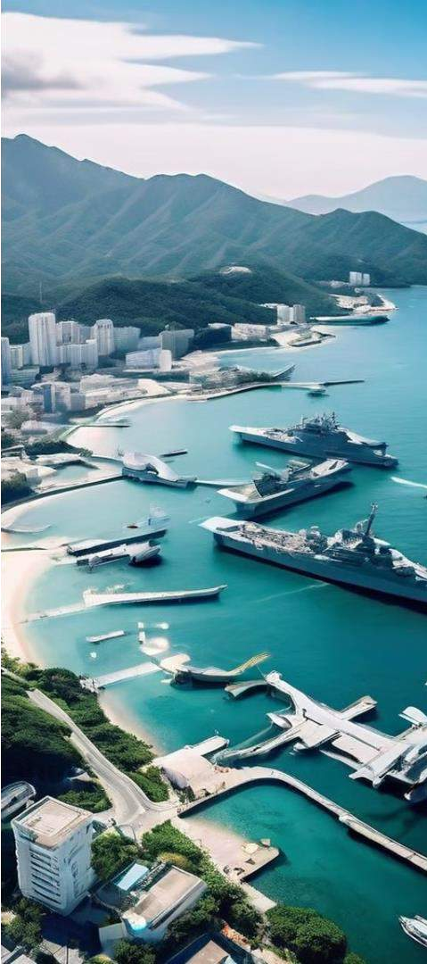
Taiwan: Flashpoint or Shared Security?
1
Evolving Security Dynamics
As China's influence expands and regional powers redefine their strategic postures, the question of whether Taiwan becomes a focal point for collaboration or contention adds a layer of complexity to the broader discourse on Asian coalitions.
2
Shared Security Interests
Examining the security dynamics surrounding Taiwan within the context of Asian coalitions prompts us to assess how shared security interests and defence cooperation cooperation could shape the intricate interplay between China, India, and other key players in the region.
3
Divergent Strategic Objectives
Conversely, the examination of Taiwan's security considerations also highlights the potential for divergent strategic objectives among the rising powers, which could lead to lead to tensions and conflicts within the broader Asian geopolitical landscape.

Slide 4
The South China Sea Disputes: Flashpoint for Asian Alliances?
Territorial Disputes
The territorial disputes in the South China Sea involve not only regional powers like China and Taiwan but also impact the the strategic calculus of nations across Asia, including India.
Shared Maritime Security
The evolving dynamics of these disputes present a litmus test for the cohesion or divergence of Asian coalitions, as nations navigate shared maritime security concerns and economic interests.
China's Assertive Claims
Examining the interplay between South China Sea tensions and the prospects prospects for Asian alliances and conflicts sheds light on how regional regional powers such as China, India, and others manoeuvre within this geopolitical chessboard, influencing the delicate balance between cooperation and
contention.

Slide 5



Japan's Diplomatic Finesse: Navigating Asian Alliances
Political Alliances
Japan plays a pivotal role in shaping the trajectory of regional cooperation, navigating delicate political relationships amid the backdrop of rising powers, including China and India.
Diplomatic Initiatives
Japan's diplomatic finesse in addressing shared concerns and cultivating cooperative relationships underscores the interconnectedness of political political relationships in shaping the future landscape of of Asian alliances and conflict resolution.
Fostering Stability
Japan's commitment to fostering stability and collaboration in the region provides insights into the mechanisms through which nations navigate the geopolitical terrain of potential potential Asian alliances and conflicts.

Slide 6


The Iran-North Korea Alliance: Implications for Asian Security
Unconventional Warfare
The Iran-North Korea strategic alliance holds significant implications for security in Asia, Asia, as the two nations have a history of unconventional warfare capabilities.
Shared Geopolitical Interests
The collaboration between Iran and North Korea raises concerns and questions about about the broader impact on Asian security, as their shared geopolitical interests introduce a complex layer to the regional dynamics.
Evolving Security Landscape
Understanding the link between the Iran-North Korea alliance and security in Asia provides insights into the evolving geopolitical challenges facing the region, potentially potentially influencing the strategies and policies of neighbouring nations.

Slide 7
Navigating the Complexities of Asian Alliances
1
Opportunities for Collaboration
The ascent of powers such as China and India introduce a myriad of opportunities for regional collaboration and stability in Asia.
2
Challenges and Tensions
The rise of these powers powers also brings forth forth challenges that can can lead to geopolitical tensions and conflicts, underscoring the need for nuanced analyses.
3
Intricate Interplay
The intricate interplay between political and security dynamics, compounded by territorial disputes and historical complexities, highlights the complexity complexity of contemplating the future future of Asian alliances. alliances.

Slide 8
Conclusion: Shaping the Future of Asian Geopolitics
Emerging Alliances
The exploration of rising powers and the potential for Asian alliances unveils a dynamic dynamic landscape that will significantly shape shape the geopolitical future of the continent. continent.
Potential Conflicts
The challenges and tensions arising from the ascent of powers like China and India underscore the need for a deeper understanding of the evolving power dynamics in Asia.
Nuanced Analysis
Navigating the complexities of Asian alliances alliances and conflicts requires a nuanced approach that considers the intricate interplay interplay of political, security, and economic factors.

Slide 9


Can India and China Get Along?

Slide 10

Territorial Disputes
1
Historical Claims
Conflicting territorial claims dating back to the early 20th century from British colonial rule.
2
1962 Border War
India and China fought a brief but intense war over border disagreements, disagreements, leading to the establishment of the Line of Actual Control Control (LAC).
3
Ongoing Tensions
Periodic skirmishes and tensions along the disputed border, including the
the 2020 Galwan Valley clash.

Slide 11
Military Buildup
Military Modernization
Provocative Maneuvers
Security Implications
Both India and China have invested heavily in modernizing their military forces and infrastructure along the border.
Large-scale military exercises and the construction of military facilities near the disputed border can be perceived as aggressive posturing.
The presence of well- equipped military forces increases the potential for confrontations and escalations along the border. border.

Slide 12
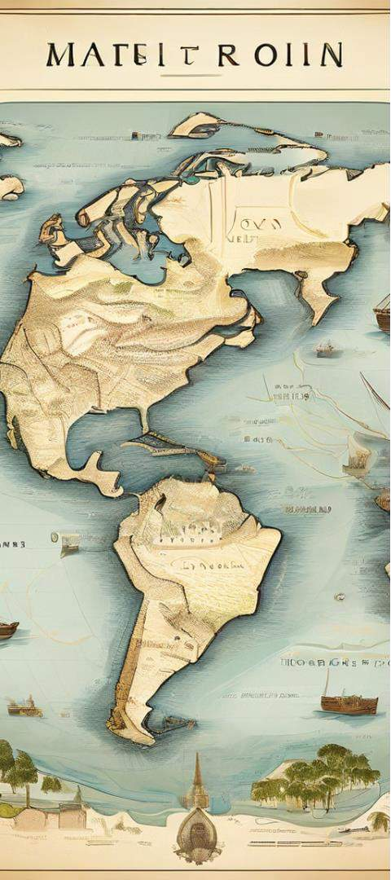
China's Maritime Initiatives
Maritime Silk Road
China's Maritime Silk Road initiatives are seen as part of its "String of Pearls" Pearls" strategy, raising concerns about about China's growing influence in India's neighborhood.
Debt Diplomacy
Some BRI projects have led to significant debt burdens for smaller nations, potentially giving China economic influence in the region.
Security Implications
India perceives the presence of Chinese assets in the Indian Ocean region as a potential
potential security threat.

Slide 13



Nepal's Strategic Role
Nepal-China Relations
China's BRI has provided Nepal, Nepal, a landlocked country, access to its ports, granting Nepal a strategic role in the region.
Impact on India
Nepal's stance on the Indo- Pacific is likely to be pro- Beijing, which could impact India's security interests in the the region.
Cooperation Potential
Joint military exercises and economic cooperation have the the potential to bring China and India closer.

Slide 14
Balancing Military Strength and Diplomacy Diplomacy
Military Capabilities
Military strength plays a crucial role in shaping the dynamics of territorial disputes between China and and India.
Diplomatic Engagement
Diplomatic efforts are necessary to achieve a lasting lasting resolution to the territorial disputes.
Comprehensive Approach
A balance between military strength and diplomatic engagement is key to managing the India-China border issue.

Slide 15

Shared Interests and Affinities
1
Economic Growth
Both China and India have experienced significant economic and technological advancements, making them contenders for regional powerhouse status.
2
Regional Proximity
India and China share a common geography and history, which can serve as a foundation for cooperation.
3
Multilateral Platforms
Platforms like BRICS and SCO provide opportunities for India and China to collaborate
collaborate and build trust.

Slide 16
The Path Forward
Diplomacy
Efforts to resolve disputes through diplomatic diplomatic channels and negotiations.
Mutual reduction of military buildup and
provocative actions along the border.
Engagement in regional and international organizations to foster cooperation and stability.
Arms Restraint
Multilateral Cooperation

Slide 17
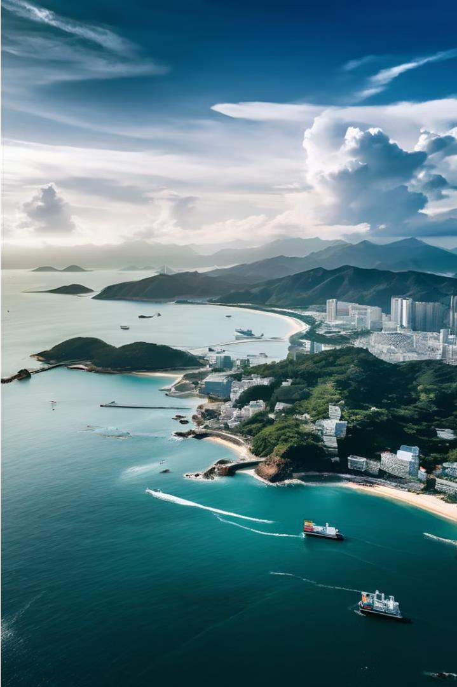
Security Concerns and Defence Cooperation in Asian
Coalitions: A Focus on Taiwan

Slide 18
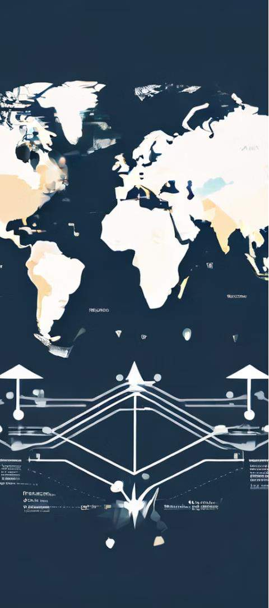
Evolving Geopolitical Dynamics in Asia
1
Shifting Power Dynamics
The region is characterized by changing power dynamics, territorial disputes, and security challenges.
2
Defence Collaboration
Examining defence cooperation within Asian coalitions is crucial to understanding the region's security security landscape.
3
Taiwan's Unique Position
Taiwan's delicate geopolitical status and complex relationship with China introduce a introduce a distinct dimension to the analysis.

Slide 19
The Taiwan Question
Surrender to China?
Cross-Strait Complexities
Implications for Stability
The question of whether Taiwan will surrender to China China is a matter of profound profound geopolitical significance.
The Taiwan issue has far- reaching implications for regional stability and the broader global geopolitical landscape.
The relationship between Taiwan and China is characterized by historical complexities, political tensions, and competing nationalistic aspirations.

Slide 20


China's Tolerance for Taiwan's Stance Stance
Historical Roots
The Taiwan issue has deep historical roots, dating back to the Chinese Civil War.
China's Perspective
China sees Taiwan as part of its territory and views reunification as a matter of matter of national sovereignty.
Nationalist Pressures
Chinese leaders face pressure from nationalist sentiments within the country, country, making a firm stance on Taiwan essential.

Slide 21

Diplomatic Balancing Act
Nationalist Sentiments
Navigating the contrasting contrasting nationalist sentiments on both sides of of the Taiwan Strait requires careful diplomatic diplomatic manoeuvring.
The "One China" Policy
The "One China" policy is a a fundamental aspect of the diplomatic challenge, with differing interpretations interpretations between China and Taiwan.
Taiwan's International International
^{R}St^{e}ri^{c}kºin^{g}g^{n}a^{it}b^{i}aºla^{n}nce between between seeking international space for Taiwan and avoiding actions that provoke China China requires diplomatic
finesse.

Slide 22



Military Dynamics
China's Military Buildup
China has significantly strengthened its military capabilities, including its ability ability to project power in the Taiwan Strait.
Taiwan's Defence Investments
Taiwan has also invested in its own defence capabilities, creating a delicate military balance.
Risk of Confrontation
The risk of military confrontation and potential for for unintended escalation require careful management.

Slide 23
Global Implications
US Strategic Interests
The US, as a key player in the region, has strategic interests in maintaining stability in the Taiwan Strait.
Broader Consequences
The Taiwan Strait issue has global geopolitical implications, shaping the broader broader power dynamics on the world stage. stage.
1
2
3
Shifting Global Dynamics
The evolving geopolitical landscape and the the alliances forged by China and Taiwan can can impact the delicate balance.

Slide 24
Deciphering the Future
Political Factors
Economic Considerations
Security Challenges
Nationalist sentiments
Trade and investment ties
Military buildup and
confrontation
Diplomatic maneuvering
Global economic implications
Potential for escalation

Slide 25

Balancing Support for Taiwan while
Neutralizing China's Influence

Slide 26

Maintaining Regional Stability
1
Prevent Escalation
of Tensions
A balanced approach helps maintain stability in the Asia-Pacific region by preventing the escalation of tensions between Taiwan and China.
2
Encourage Peaceful
Peaceful Resolution
^{R}En^{e}c^{s}oºu^{l}r^{u}a^{t}g^{i}iºng^{n}a balanced approach supports the peaceful resolution of disputes over Taiwan's status.
3
Promote
Cooperation
Economic ties promote cooperation, reduce the the likelihood of conflict, conflict, and contribute to mutual prosperity in the region.

Slide 27
Diplomatic Balancing Act
Diplomatic Ambiguity
Track II Diplomacy
Multilateral Approaches
Maintaining diplomatic ambiguity by avoiding explicit explicit statements that could could escalate tensions.
Engaging in unofficial, non- governmental channels of communication between different parties.
Working within international organizations to address regional concerns and engaging in multilateral forums.

Slide 28
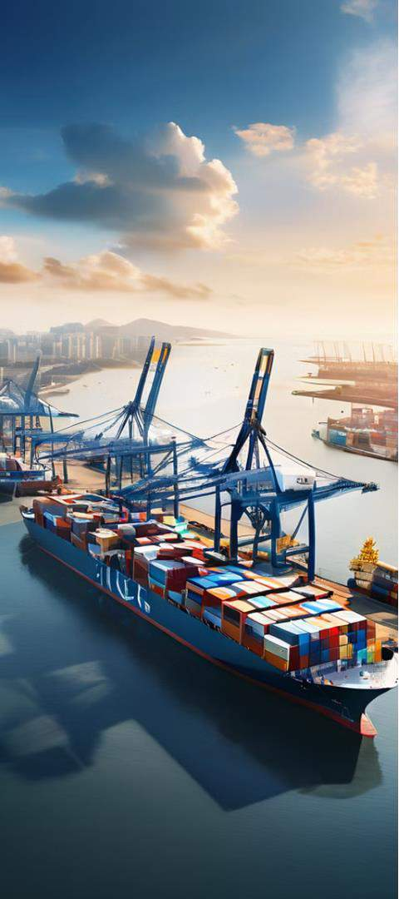
Economic Interdependence
Fostering Economic Ties
Encouraging trade agreements and investment with both Taiwan and China China to promote economic interdependence.
Mutual Prosperity
Economic ties can act as a stabilizing force, encouraging peaceful relations and contributing to mutual prosperity in prosperity in the region.

Slide 29


Cultural Exchanges
People-to-People Connections
Promoting cultural and educational exchanges between Taiwan and China can foster mutual understanding.
Educational Cooperation
Encouraging educational exchanges can create connections between people on both sides.

Slide 30


Upholding Democratic Values
Indirect Influence
Encouraging democratic principles and practices can indirectly influence
China's behaviour while supporting Taiwan's values.
Human Rights Emphasis
Emphasising the importance of human rights and democracy can contribute contribute to a more stable and cooperative international environment.
Peaceful Solutions
Promoting peaceful resolutions to conflicts and rewarding peaceful solutions solutions are essential for maintaining regional stability.

Slide 31

Strengthening Regional Security
1
Diplomatic Efforts
Engaging in diplomatic efforts to reduce military tensions and enhance regional stability.
2
Ensuring Security
Strengthening security cooperation in the region, ensuring that all parties
parties feel secure without necessarily taking sides.
3
Preventing Escalation
Reducing the risk of military escalation in the Taiwan Strait is critical for
regional security and global peace.

Slide 32
Navigating Geopolitical Complexities
Diplomatic Ambiguity | Avoiding explicit statements that could escalate tensions
Track II Diplomacy | Encouraging unofficial, non-governmental channels of communication
Economic Cooperation | Fostering economic ties with both Taiwan and and China
Multilateral Approaches | Working within international organizations to to address regional concerns

Slide 33
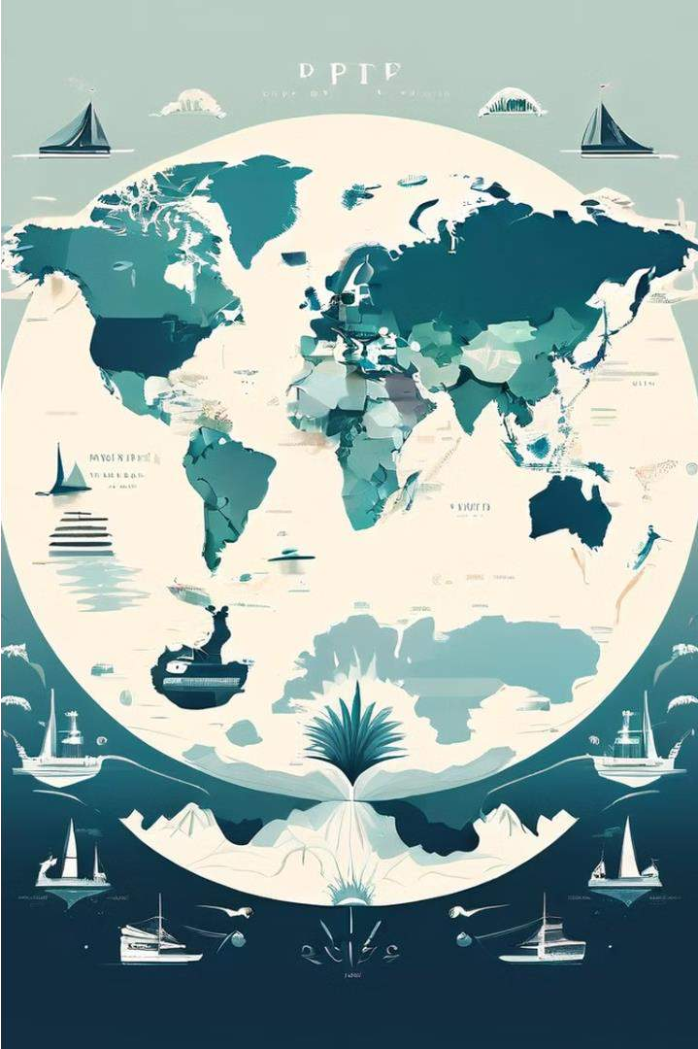
New Alliances, New Challenges: A
Glimpse into the Indo-Pacific's Future
The Indo-Pacific region is a crucible of emerging alliances and complex challenges, shaping a new trajectory of global affairs. This section explores the multifaceted dynamics defining the political and strategic contours of this consequential expanse.

Slide 34
Shifting Tides of Geopolitical Alliances
Redefined Partnerships
Old alliances are being redrawn, and new partnerships are emerging, reflecting the fluidity and adaptability demanded by the challenges ahead.
Reshaping the Geopolitical Landscape
The shifting tides of alliances are transforming the geopolitical landscape, with with implications for regional stability and the the broader global order.
1
2
3
Navigating Cooperation and Competition
Nations in the Indo-Pacific are navigating the the delicate balance between cooperation and competition, shaping the region's future future trajectory.

Slide 35
The Quad and AUKUS: Balancing Against China
The Quad
AUKUS
Balancing Against China
The Quadrilateral Security Dialogue (Quad) comprises the US, Australia, Japan, and India, aiming to maintain a free, open, and inclusive Indo-Pacific.
AUKUS is a strategic alliance between Australia, the UK, and the US, focused on enhancing joint deterrence and defense capabilities in the Indo-Pacific.
These minilateral arrangements are a response response to China's assertive assertive behavior, seeking to to counterbalance its growing growing influence in the region.

Slide 36
Motivations of the Quad Members
1
India
Safeguarding maritime interests, promoting regional stability, and fostering economic growth through cooperative initiatives.
2
Australia
Upholding a rules-based international order, ensuring freedom of navigation, and and deterring potential threats to regional regional security.
3
Japan
Enhancing security cooperation, strengthening diplomatic ties, and promoting economic resilience in the Indo- Indo-Pacific.
4
United States
Advancing regional stability, security, and and shared democratic values, while countering China's growing influence.

Slide 37
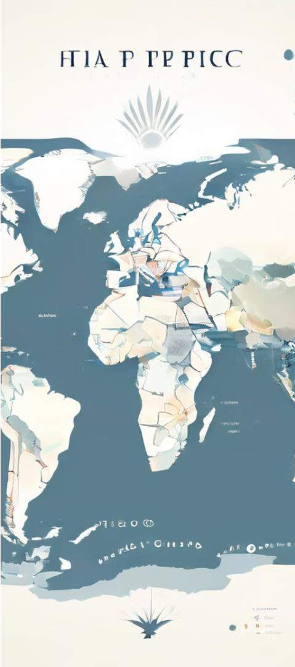
Core and Peripheral States in the Indo-Pacific
Core States
The US, Australia, Japan, and India are are the core states shaping the geopolitical landscape and addressing addressing challenges in the Indo- Pacific.
Peripheral States
Thailand and the Philippines, while geographically situated in the region, are on the periphery due to their more nuanced foreign policy approaches.

Slide 38


The Role of European Powers in the Indo- Pacific
NATO-Asia Alignment
NATO acknowledges China's challenges to its interests, security, and values, leading to closer NATO-Asia alignments.
EU-Asia Partnerships
The European Union is also actively engaged in the Indo-Pacific, fostering economic and security security cooperation with regional partners.

Slide 39


Multilateralism vs. Minilateralism
Multilateralism
The European powers are advocates for multilateralism, while China, India, Russia, and the US possess the flexibility to engage in unilateral, bilateral, or multilateral actions.
Minilateralism
Minilateral arrangements, such as the Quad and AUKUS, have emerged as a a positive response to China's assertiveness, offering agile and flexible alliances.
Implications
The outcomes of this shift from multilateralism to minilateralism will have far- far-reaching implications for the regional and global order.

Slide 40
Navigating the Complexities of the Indo- Indo-Pacific
Cooperation | Competition
Maintaining economic prosperity | Countering China's influence
Upholding rules-based approach | Adapting to shifting power dynamics
Promoting democratic principles | Ensuring peaceful stability

Slide 41

Political Alliances and Diplomatic Initiatives:
Japan's Role in Asian
Coalition Formation

Slide 42
Japan's Proactive Diplomacy
Sino-US Rivalries
Relationships with
Neighbors
Pursuit of Shared
Objectives
Japan's diplomacy is shaped by the growing tensions between China and the US, as it seeks to navigate the shifting geopolitical landscape.
Japan's diplomatic initiatives reveal the nuances of its relationships with neighboring states, including both cooperation and conflicts.
Japan's diplomacy aims to cultivate strategic partnerships and align with other nations to pursue shared regional and global objectives.

Slide 43
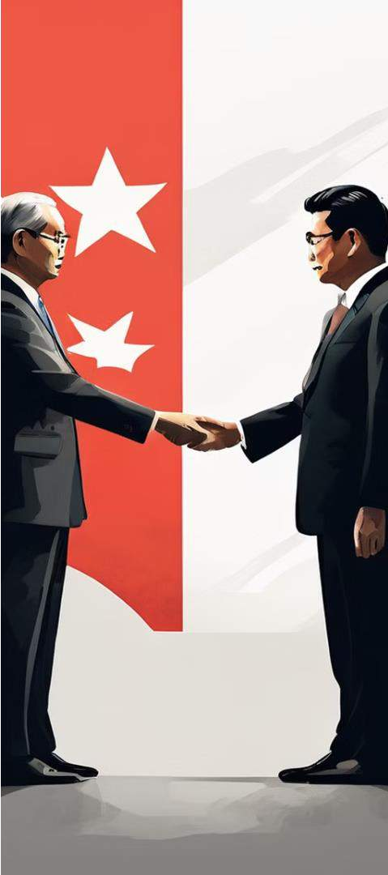
Evolving Japan-China Relations
1
Tensions and Disputes
Japan and China have faced conflicts over issues ranging from maritime territories to radioactive water disposal and detention of citizens.
2
Efforts to Mend Ties
In November 2023, a Japanese political party visited China to try to improve
improve the frayed bilateral relationship.
3
Potential for Closer Ties
The perceived decline of US influence in the Pacific may drive China and
Japan to form a closer Asian alliance.

Slide 44
Japan's Evolving Military Capabilities
1
Expanding Military Role
Japan is now allowing its soldiers to be stationed outside its borders, signaling a shift in its security posture.
2
Advanced Weapons Development
Japan has developed a range of cutting- edge military technologies, including hypersonic weapons and unmanned underwater vehicles.
3
Removal of Weapons Export Ban
In 2014, Japan lifted its longstanding ban ban on weapons exports, further bolstering bolstering its military industrial capabilities. capabilities.
4
Potential for Rapid Military Buildup
Experts suggest that Japan has the ability ability to quickly transform itself into a global military power if it chooses to do so. so.

Slide 45

The Importance of Japan for US and Europe
Countering China's Ambitions
The US and Europe see Japan as a crucial ally in countering China's efforts efforts to build a global power bloc in
in Asia.
Reliable Partner in Regional Security
Japan's growing military capabilities and willingness to engage in regional security operations make it a valuable partner for the US and Europe.
Balancing Geopolitical Alignments
As Japan navigates its relationships with various powers, the US and Europe seek to maintain Japan's allegiance to the Western-led order.

Slide 46

Navigating Historical, Ideological, and Political Complexities
Historical Legacies
Japan's diplomatic relations in Asia are influenced by the legacy of its past conflicts and wartime experiences.
Ideological Differences
Varying political ideologies and worldviews among Asian nations pose challenges for Japan in forging coalitions.
Geopolitical Realities
Japan must carefully balance its interests and align with different powers to to navigate the complex regional geopolitical landscape.

Slide 47


Multilateralism and Minilateralism in Japan's Diplomacy
Multilateralism
Japan recognizes the advantages of multilateral cooperation and engagement engagement in regional and global affairs.
Minilateralism
Japan also leverages minilateral relationships to mitigate the drawbacks of exclusive treaty agreements.
Flexibility in Alliances
Japan's diplomatic approach seeks to balance the benefits of both multilateral and minilateral frameworks.

Slide 48
Conclusion: Japan's Pivotal Role in Asian Asian Coalition Formation
Proactive Diplomacy | Japan's diplomatic initiatives shape regional dynamics and cultivate strategic partnerships.
 | partnerships.
Evolving Military Capabilities | Japan's growing military prowess and
 | technological advancements expand its
 | regional influence.
Balancing Alliances | Japan navigates complex historical, ideological, and political factors to forge
Importance for Global Powers | strategic alliances. The US and Europe recognize Japan's significance in countering China's ambitions and maintaining a rules-based order.

Slide 49
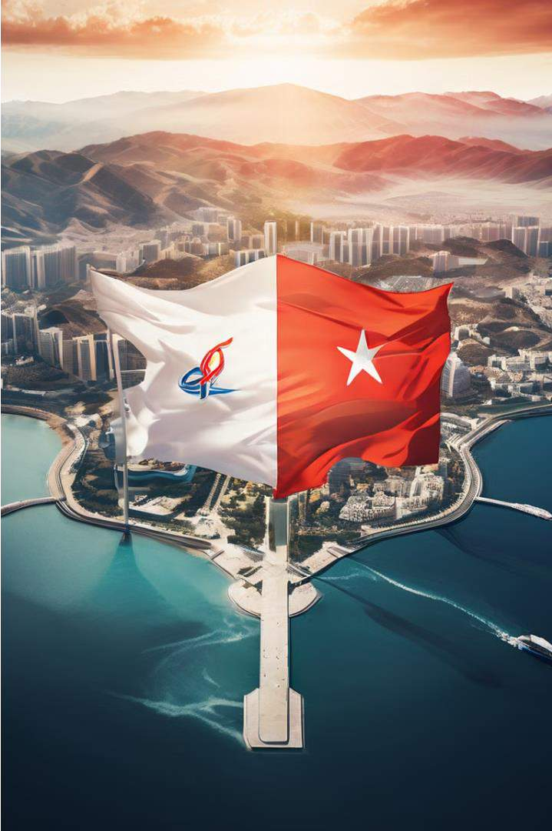
The North Korea-Iran Strategic Alliance
The growing strategic alliance between Iran and North Korea has significant implications for Asian security dynamics. This alliance, rooted in shared hostility towards the US and a need to withstand global isolation, involves military and nuclear technology collaboration.

Slide 50

Military Collaboration
1
Arms Sales
During the Iran-Iraq war, North Korea provided military expertise and hardware to Iran.
2
Missile Development
North Korea is collaborating closely with Iran's missile development
program, including the transfer of sensitive technologies.
3
Nuclear Cooperation
Iranian scientists have been present during North Korean nuclear tests, and
and the two countries have exchanged nuclear technologies.

Slide 51
Missile Capabilities
Nodong-1 Missile
Shahab-3 Missile
Intermediate-Range Missiles
North Korea developed the Nodong-1 missile, which it exported to Iran, extending its its range to 1,300 km and placing Israel within striking distance.
The Shahab-3, a medium- range ballistic missile, is the cornerstone of Iran's missile arsenal, with collaboration from North Korea.
North Korea has also introduced road-mobile intermediate-range ballistic missiles, further enhancing its its missile capabilities with potential implications for Iran. Iran.

Slide 52
Nuclear Cooperation
1
Nuclear Tests
Iranian scientists have been present during North Korean nuclear tests, indicating ongoing collaboration in this area.
2
Uranium
Centrifuges
North Korea has shared its expertise in uranium centrifuge technology with Iran, further advancing their nuclear programs.
3
Illicit Transfers
North Korea has been involved in the illicit transfer of nuclear materials and technologies to other nations, including Iran and Syria.

Slide 53
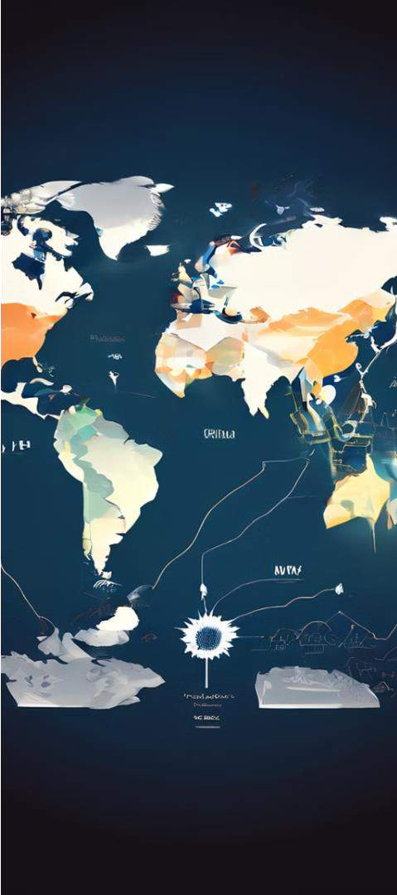
Geopolitical Implications
Global Concern
North Korea's nuclear development program and potential collaboration with Iran have raised alarms within the the international community.
Proliferation Risks
The prospect of North Korea engaging in the import and export of nuclear technologies poses a challenge to the global non-proliferation efforts.
Regional Tensions
The Iran-North Korea alliance has the potential to exacerbate regional tensions and
security dynamics in Asia.

Slide 54

Missile Technology Transfers
Scud-C Missiles
North Korea exported the Scud-C (Shahab-2) missile with a range of 500 km
km to Iran and Syria.
Uranium Hexafluoride
North Korea also supplied Libya with 1.8 metric tons of uranium hexafluoride, hexafluoride, which was intended for a reactor built for Syria.
Israeli Intervention
In 2007, Israel bombed a Syrian facility that had received a shipment of nuclear materials from North Korea.

Slide 55


Technological Advancements
Missile Capabilities
North Korea has developed road-mobile intermediate-range range ballistic missiles, further further enhancing its missile arsenal.
Uranium Centrifuges
North Korea has shared its expertise in uranium centrifuge centrifuge technology with Iran, Iran, advancing their nuclear programs.
Nuclear Tests
North Korea has conducted multiple nuclear tests, raising global concerns about its nuclear development program. program.

Slide 56
Ongoing Challenges
Proliferation Risks
The prospect of North Korea engaging in the the import and export of nuclear technologies technologies poses a challenge to the global global non-proliferation efforts.
Regional Tensions
The Iran-North Korea alliance has the potential potential to exacerbate regional tensions and and security dynamics in Asia.
Global Concern
North Korea's nuclear development program program and potential collaboration with Iran Iran have raised alarms within the international international community.

Slide 57

Conclusion
The ascent of powers like China and India presents both opportunities for opportunities for collaboration and challenges that can lead to tensions tensions and conflicts. Navigating this complex landscape requires a balance of cooperation and competition to maintain regional stability and and prosperity.

Slide 58
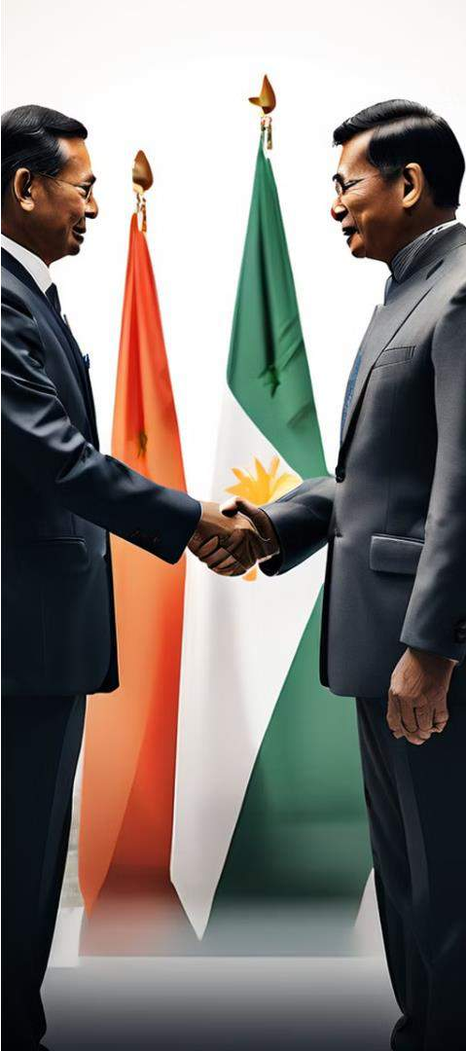
Fostering Cooperation Between China and India
1
Joint Military Exercises
Joint military exercises can foster greater cooperation, build trust, and improve bilateral relations between China and India.
2
Economic Cooperation
Increased economic cooperation, such as through initiatives like the SCO and BRICS, can bring China and India closer together.
3
Predictable Rules-Based Relationship
Establishing a predictable, rules-based relationship can help manage
tensions and maintain stability between the two nations.

Slide 59

Navigating the Taiwan Conflict
Balancing Support for Taiwan
Maintaining a balanced approach that supports Taiwan while neutralizing
China's influence is crucial for regional stability.
Fostering Diplomatic Solutions
Encouraging diplomatic solutions and avoiding confrontation can contribute to a more stable and cooperative international environment.
Preventing Escalation
A balanced approach helps maintain stability in the Asia-Pacific region by preventing the escalation of tensions between Taiwan and China.

Slide 60
Countering the Iran-North Korea Alliance
Security Concerns
Regional Dynamics
Justification for
Alliances
The Iran-North Korea alliance alliance raises concerns about the potential for the proliferation of nuclear and unconventional warfare capabilities in Asia.
Understanding the link between the Iran-North Korea Korea alliance and security in in Asia provides insights into the evolving geopolitical challenges facing the region. region.
Alliances formed to prevent the complexities of an arms race in Asia are justified in the the face of this alliance.

Slide 61
The Evolving Geopolitical Landscape
1
Multipolarity
The global landscape is shifting towards multipolarity, with numerous nations favoring adaptable alignments over rigid alliances.
2
Minilateralism
The transition from multilateralism to minilateralism presents a a fundamental shift in the geopolitics of the Indo-Pacific.
3
Emerging Powers
The rise of emerging powers, particularly China, has challenged the unipolar structure and ushered in a more multipolar distribution of of power.

