Slide 1
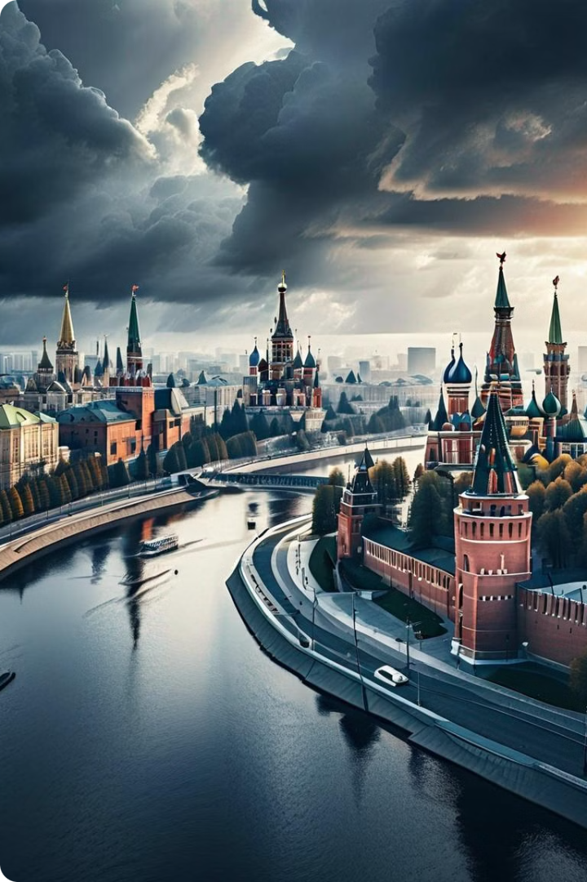
Russia's Resurgence: A New Era in Geopolitics
Russia's resurgence has captivated global attention, as the nation reasserts its influence on the world stage through military assertiveness, strategic alliances, and economic advancements.

Slide 2
Towards the Restoration of the Russian Empire
1
Imperial Past
The Russian Empire spanned centuries, from the reign of Peter the Great to the fall of the Romanovs in 1917.
2
Dissolution of the USSR
The collapse of the Soviet Union in 1991 led to the emergence of independent states, marking a significant geopolitical shift.
3
Resurgence Efforts
Russia's annexation of Crimea and conflicts in Georgia are seen as attempts to revive its influence in the post-Soviet space.

Slide 3
Geopolitical Tensions and Energy Dependency
Energy Security Concerns
Germany's Dilemma
Navigating Alliances
Germany's economic ties with Russia conflict with its energy security concerns, creating a complex balancing act.
Russia's relationships with Asian, Middle Eastern, and Horn of Africa states could fortify its resurgence.
Europe's heavy reliance on Russian natural gas raises fears of Russia using energy as a geopolitical tool.

Slide 4
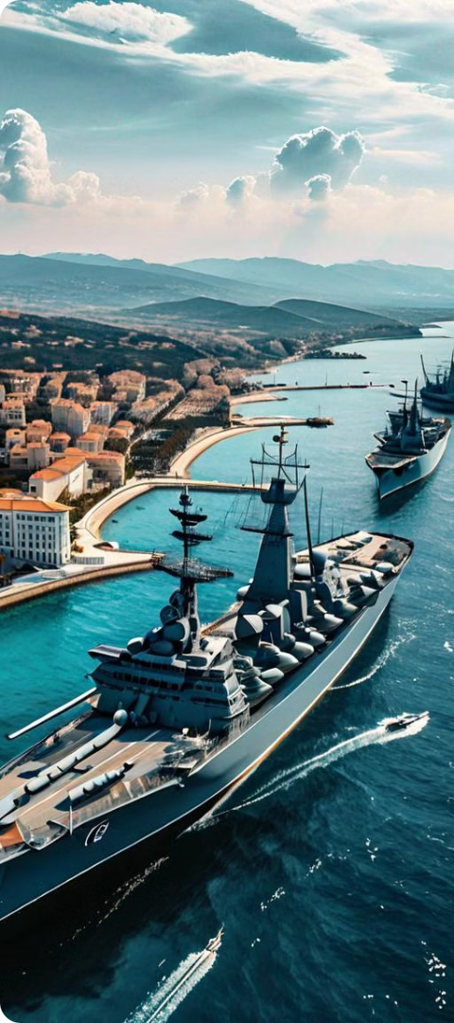
The Black Sea: A Strategic Battleground
Energy Transportation
Naval Dominance
Pipelines in the Black Sea region are crucial for transporting Russian natural gas to Europe.
Russia's Black Sea Fleet provides access to the Mediterranean and allows for power projection in the region.
Geopolitical Significance
The Black Sea's strategic location makes it a key focus for Russia's efforts to exert regional influence.

Slide 5
The Ukraine Crisis: A Turning Point
Yanukovych's Dilemma
Russia's Intervention
Geopolitical Consequences
The Ukrainian president faced a choice between aligning with the EU or Russia, ultimately leading to his downfall.
The annexation of Crimea and support for separatists in eastern Ukraine marked a significant escalation of the crisis.
The Ukraine crisis has strained Russia's relations with the West and altered the geopolitical landscape in Eastern Europe.

Slide 6
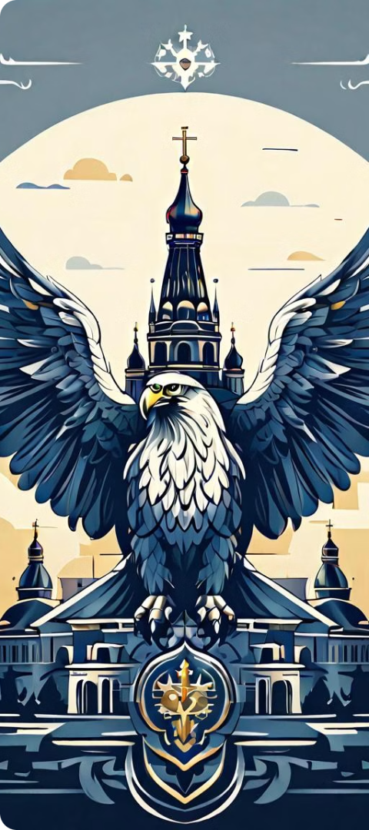
Restoring the Russian Empire: Aspirations and Realities
1
National Pride
2
Geopolitical Tensions
Restoring the Russian Empire is seen by some as a way to rekindle a sense of national pride and continuity.
The idea of restoring the empire raises concerns among Russia's neighbors and the international community.
3
Autocratic Concerns
Critics highlight the autocratic nature of the imperial system and its potential to exacerbate regional tensions.

Slide 7
Russia's Alliances and Partnerships
Strategic Partnerships
Global Influence
Geopolitical Maneuvering
Russia has forged alliances with Asian, Middle Eastern, and Horn of Africa states, diversifying its geopolitical relationships.
These alliances could potentially strengthen Russia's position and contribute to its resurgence on the global stage.
Russia's pursuit of these partnerships reflects its strategic efforts to expand its influence and counter Western dominance.

Slide 8
Challenges and Opportunities for Russia's Resurgence
Challenges
Opportunities
Dependence on European energy markets
Diversification of global partnerships
Strained relations with the West
Strengthening regional influence in the Black Sea and beyond
Concerns over autocratic tendencies
Rekindling national pride and aspirations

Slide 9
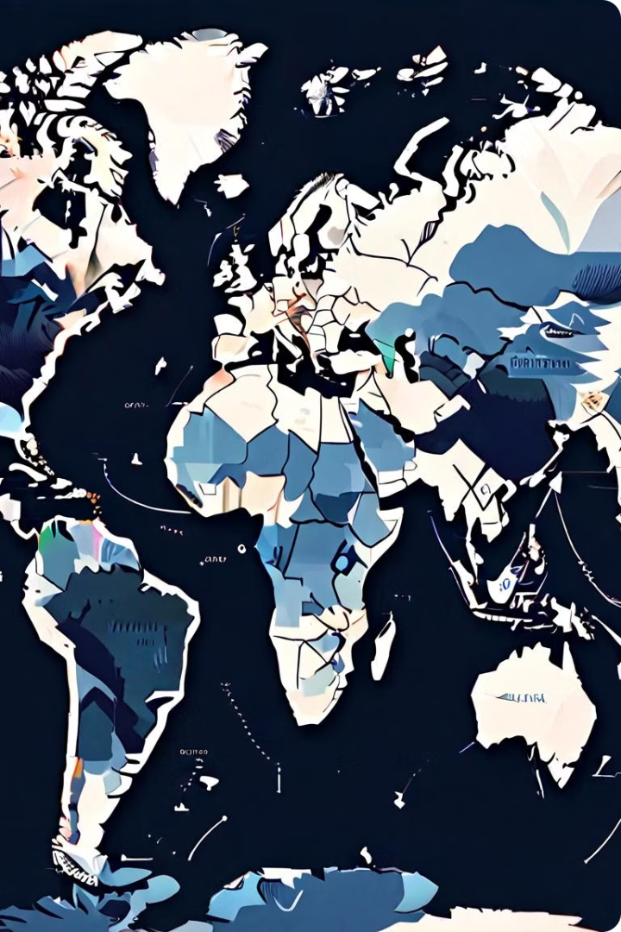
Russia and the Emerging Asian Powers
The evolving relationships between Russia and emerging Asian powers, notably China and India, have significant geopolitical implications, shaping the dynamics of Eurasian and global politics.

Slide 10
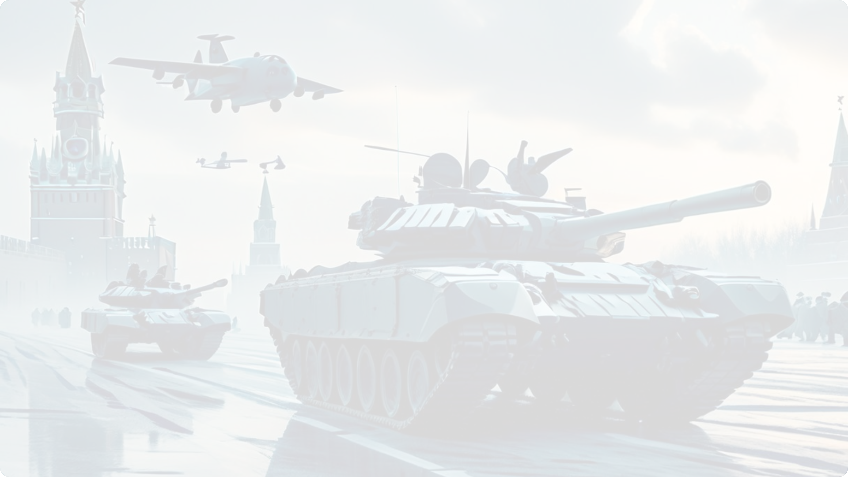
Russia's Pivot to Asia
Arms Supplier
1
Russia has become a major arms exporter to Asian countries, including Vietnam, Indonesia, and India.
2
Strategic Partnerships
Russia has strengthened its partnerships with China and India, seeking to counter Western influence.
Expanding Influence
3
Russia is gaining influence in Asia, challenging the US and NATO's presence in the region.

Slide 11
The China-Russia Relationship
Shared Interests
Economic Ties
Geopolitical Alignment
China and Russia have a "no-limits" partnership, united in their opposition to US dominance.
China is a crucial energy market for Russia, with bilateral trade surging in recent years.
The Sino-Russian alliance aims to challenge the international order and promote authoritarian rule.

Slide 12
India's Balancing Act
Ties with Russia
Relationship with US
India maintains a strong partnership with Russia, despite US sanctions and pressure.
India also seeks to maintain close ties with the US and European powers.
Geopolitical Positioning
Strategic Importance
India aims to bridge divides and balance its relationships with various powers.
India's role is seen as crucial in shaping the geopolitical landscape in Asia.

Slide 13
Implications for the International Order
1
Shifting Balance of Power
2
Strengthening BRICS
Russia's relationships with China and India challenge US influence and contribute to a multipolar world.
Putin's diplomatic acumen has solidified Russia's partnerships within the BRICS framework.
3
Concerns for the West
The Russia-China-India alliance raises concerns for the US, NATO, and European states.

Slide 14
Implications for Japan and Taiwan
Japan's Perspective
Japan's relationship with Russia has evolved, leading to greater alignment with NATO.
Taiwan Concerns
The Ukraine conflict raises fears that China may attempt to seize Taiwan.
Strategic Responses
The US and its allies are strengthening their alliances and deterrence capabilities.

Slide 15
India's Pragmatic Approach
Energy Ties
Balancing Partnerships
Defense Cooperation
India has increased oil imports from Russia, despite Western sanctions.
India seeks to maintain its relationships with the US, Europe, and Russia.
India continues to rely on Russian arms, while enhancing ties with the US.

Slide 16
Navigating a Multipolar World
Challenges
Opportunities
Maintaining US and European influence in Asia
Strengthening alliances and deterrence capabilities
Addressing the Russia-China-India alliance
Leveraging India's strategic positioning
Ensuring stability in the Taiwan Strait
Promoting a rules-based international order

Slide 17
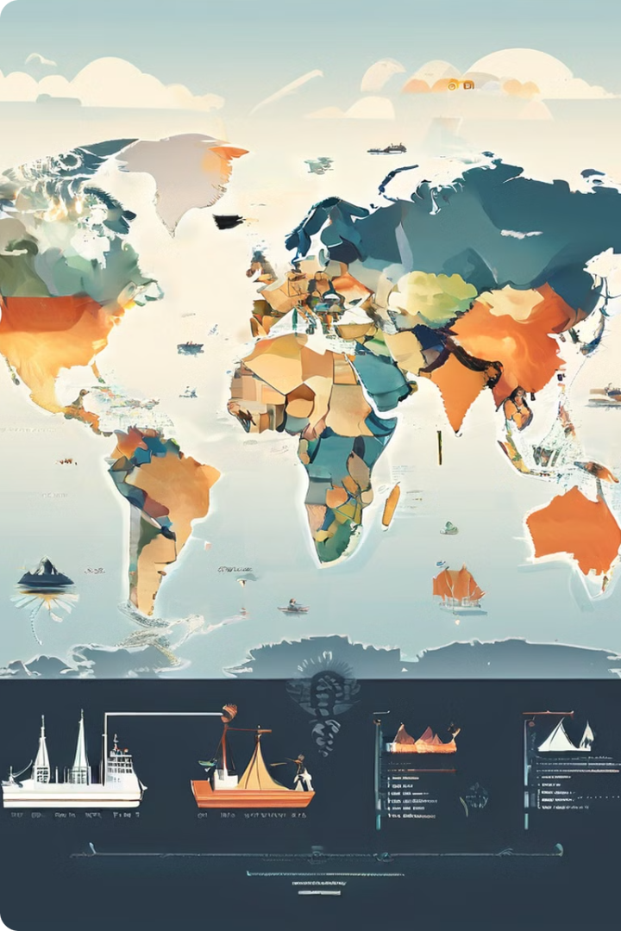
Russia's Role in the Middle East
Russia's resurgence in the Middle East has been marked by strategic partnerships, military interventions, and diplomatic maneuvers. Moscow's engagement in the region has challenged traditional power balances and introduced a new layer of complexity to regional conflicts.

Slide 18
Motives for Russia's Involvement
1
Historical Ties
2
Geopolitical Significance
Russia has historical ties with certain Middle Eastern countries dating back to the Cold War era. Rekindling these relationships allows Russia to revive alliances and strengthen its presence in the region.
The Middle East is strategically important due to its geopolitical significance and vast energy resources. Russia aims to enhance its influence and participate in shaping regional and global affairs.
3
Economic Opportunities
4
Counterterrorism
The Middle East is a major energy hub, and Russia seeks economic opportunities through energy cooperation. This includes partnerships with oil and gas-producing countries, investments in energy infrastructure, and participation in regional energy projects.
Russia is motivated by a desire to counter terrorism and extremism, which it views as threats to its own national security.

Slide 19
Military Presence and Strategic Advantages
Tartus Naval Base
Syrian Conflict
Russia's military presence in the Middle East, particularly in Syria, provides it with a crucial foothold in the Mediterranean. The Tartus naval base in Syria is Russia's only Mediterranean naval facility, offering strategic advantages and projecting power beyond its immediate borders.
The Syrian conflict allowed Russia to support the Assad regime under the pretext of fighting terrorism and protecting its interests in the region. This dual approach allowed Russia to position itself as a key player in the fight against extremism while simultaneously advancing its geopolitical objectives in the Middle East.

Slide 20
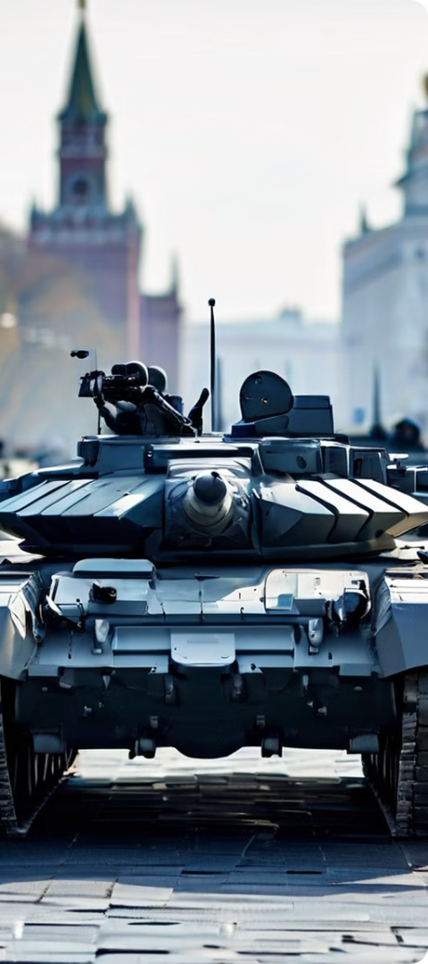
Arms Exports and Geopolitical Partnerships
Lucrative Market
Strategic Partnerships
Russia is a major arms exporter, and the Middle East represents a lucrative market for Russian weaponry. Establishing military partnerships with countries in the region allows Russia to strengthen its defence industry and build political ties.
The strategic move to forge military partnerships with nations in the region, notably Iran and others, serves as a multifaceted approach for Moscow. This engagement enables Russia to bolster its defence industry, fostering technological advancements and ensuring a continuous demand for its military hardware.
Political Ties
By cultivating these military ties, Russia concurrently establishes and strengthens political relationships, solidifying its influence in the complex geopolitical landscape of the Middle East.

Slide 21
Russia's Relationship with Iran
Strategic Alliance
Supporting the Russian Conflict
US Sanctions
Strengthening Relations
Entities such as Iran Air Cargo, Safiran Airport Services, and their parent company Iran Air are currently under US sanctions due to their involvement, along with Armenia, in transferring Iranian drones to Russia.
Iran and Russia maintain a strategic alliance, constituting an axis in the Caucasus alongside Armenia.
Armenia, a democratic state, is assisting Iran in its backing of the Russian conflict in Ukraine, aiding Moscow in circumventing sanctions by facilitating the transfer of Iranian drones and missiles through Armenian airspace and airports.
Putin states that, “We have very good relations with Iran. And we will enhance them in every possible way... That is why we do our utmost in order to develop relations with Iran and will keep this up in the future.”

Slide 22
Russia's Relationship with Turkey
Amicable Relations
Throughout the course of Russia's invasion of Ukraine, Turkey has stood out as the most amicable among NATO countries toward Moscow. It has refrained from implementing sanctions or discontinuing flights between the two nations, maintaining close cooperation with Moscow on various matters.
Strategic Partnership
Like India, Turkey is still in its quest for the right strategic partnership and considers its ties with Russia and the European powers as separate entities.
1
2
3
4
Arms Deals
Erdogan's Statement
Turkey has also been able to make arms deals with Russia. The transfer of the S-400 air defence system from Russia to Turkey in July 2019 marked a significant juncture in Russian-Turkish relations.
Erdogan states “To the extent the West is reliable, Russia is equally reliable. For the last 50 years, we have been waiting at the doorstep of the EU and, at this moment in time, I trust Russia just as much as I trust the West.”

Slide 23
Implications for Israel
Adversaries of Israel
Beneficial Relationship
Adversary of Russia
Both Turkey and Iran are the adversaries of Israel.
Having a relationship with Turkey and Iran, not Israel, is more beneficial to Moscow.
Consequently, Israel will be the adversary of Russia.

Slide 24
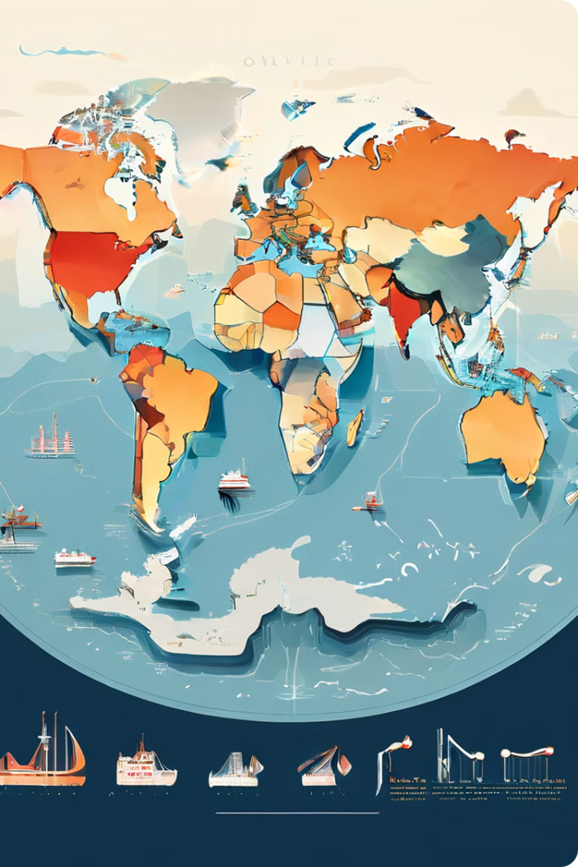
Russia's multifaceted role in the Middle East is a testament to its ambitions and the evolving dynamics of international relations. Moscow's engagement in the region has challenged traditional power balances and introduced a new layer of complexity to regional conflicts.

Slide 25
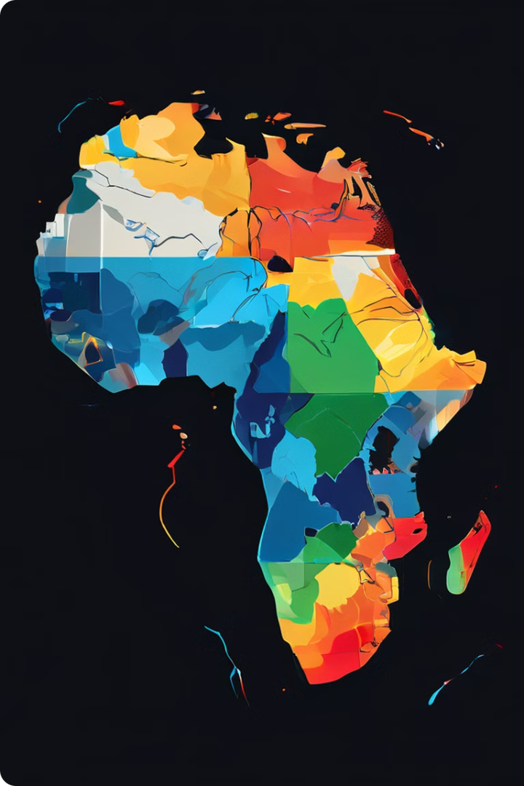
Russia’s Growing Influence in the Horn of Africa
Russia's engagement in the Horn of Africa has become a focal point of global attention, driven by Moscow's ambition to expand its influence and secure economic and security interests in the region. The Horn of Africa, strategically located at the crossroads of major trade routes and maritime chokepoints, is increasingly becoming a battleground for global powers.

Slide 26
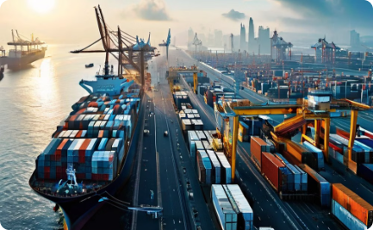
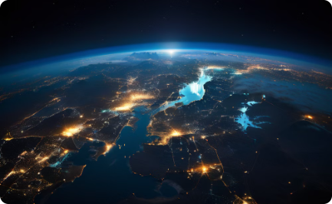
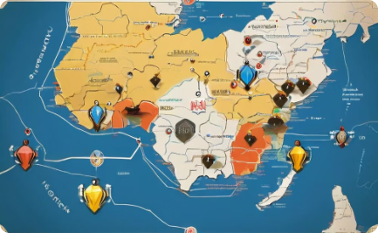
Strategic Importance of the Horn of Africa
Maritime Routes
Economic Potential
Security Concerns
The Horn of Africa is home to the Bab el-Mandeb Strait, a crucial maritime passage connecting the Red Sea and the Indian Ocean. Control of this waterway is essential for global trade and energy security.
The Horn of Africa has significant economic potential, particularly in sectors like agriculture, mining, and energy. Russia sees the region as a promising market for its investments and exports.
The Horn of Africa faces numerous security challenges, including terrorism, piracy, and inter-state conflicts. Russia's engagement is partly motivated by its desire to play a role in regional security.

Slide 27
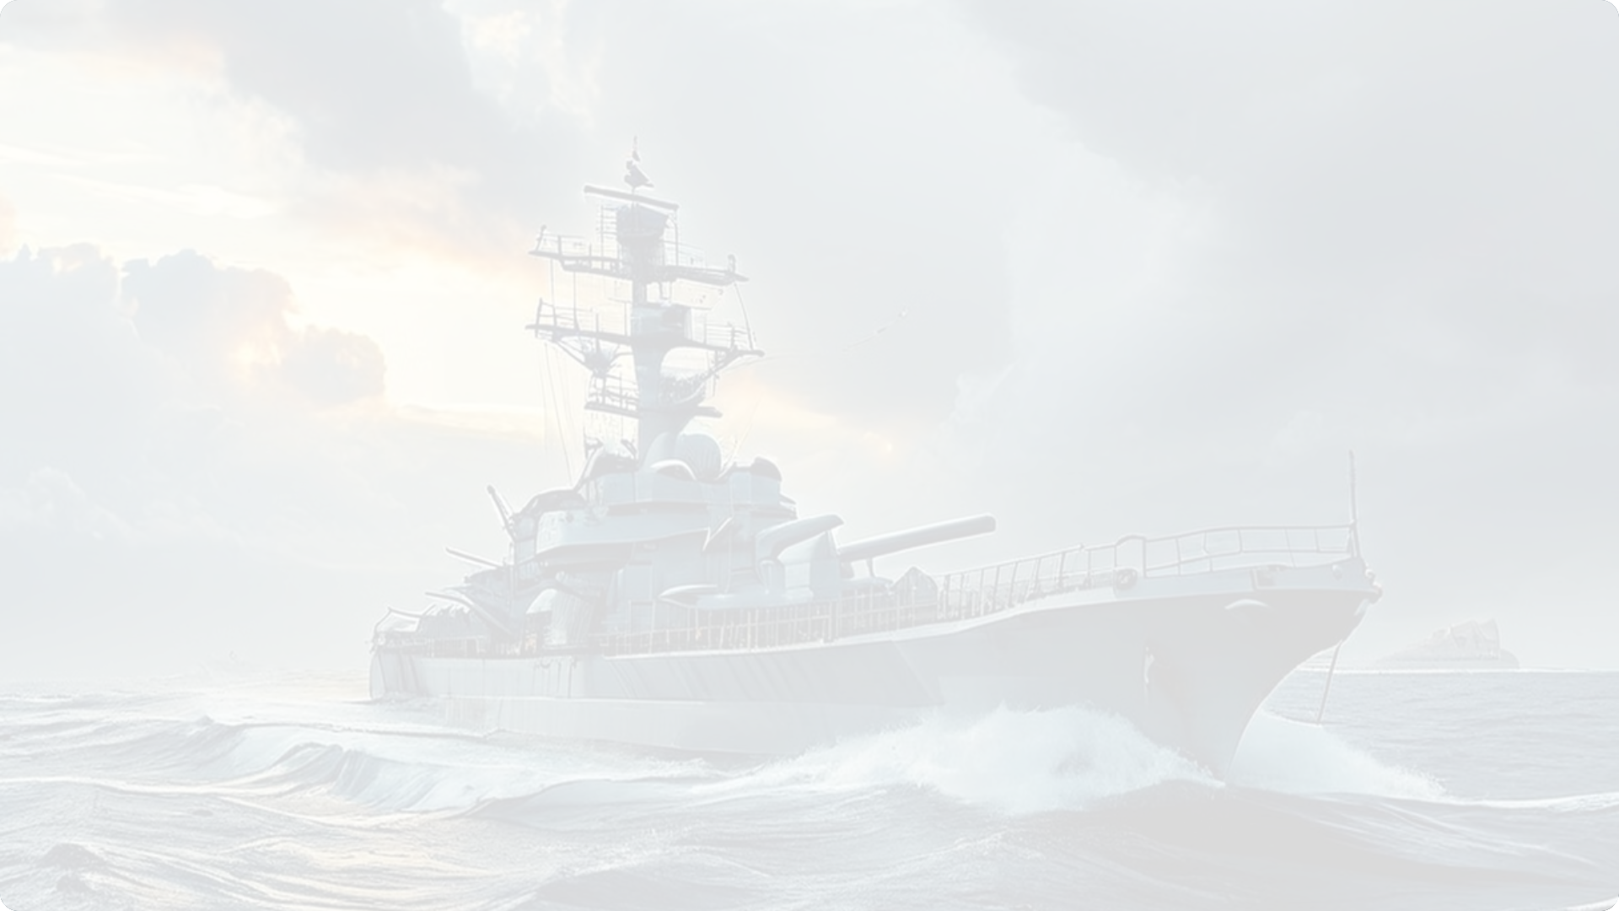
Russia's Military Presence and Partnerships
1
2
3
Base Access
Arms Sales
Military Partnerships
Russia has secured access to naval facilities in Sudan, allowing its warships to operate in the Red Sea and the Gulf of Aden, enhancing its military presence and projecting power in the region.
Russia has been a major supplier of arms to countries in the Horn of Africa, particularly Sudan and Ethiopia. These sales bolster Russia's defense industry and economic interests while strengthening its military ties.
Russia has engaged in joint military exercises and training programs with countries in the Horn of Africa, fostering military cooperation and increasing its influence on regional security affairs.

Slide 28
Diplomatic Engagement and Conflict Resolution
1
Mediation Efforts
2
Alternative Mediator
Russia has participated in diplomatic efforts to mediate and resolve regional conflicts, positioning itself as a key player in peacemaking and fostering alliances with regional actors.
Russia has presented itself as an alternative mediator in conflicts, challenging the dominance of other major powers and seeking to enhance its influence in international affairs.
3
Countering Terrorism
4
Political Influence
Russia has expressed concerns about the spread of terrorism in the Horn of Africa and engaged in security cooperation with countries like Sudan, aligning with its national security interests.
Russia seeks to enhance its political influence in the Horn of Africa by balancing relationships with various states, diversifying its geopolitical relationships, and challenging the influence of other major powers.

Slide 29
Economic Ventures and Investments
Infrastructure Projects
Trade and Investment
Economic Cooperation
Russia has shown interest in infrastructure development projects in the Horn of Africa, such as road construction and energy projects, seeking to benefit from the region's economic growth.
Russia has sought to increase trade and investment in the Horn of Africa, exploring opportunities in sectors like mining, agriculture, and energy, aiming to expand its economic footprint in the region.
Russia has engaged in economic cooperation with countries in the Horn of Africa, fostering partnerships and promoting joint ventures, hoping to secure access to resources and markets.

Slide 30
Potential for Military Bases
Strategic Advantages
Discussions with Eritrea
Regional Security
Military bases provide Russia with strategic advantages, allowing it to project power, monitor regional developments, and contribute to its global military posture.
Russia has explored the possibility of establishing military bases in the Horn of Africa, including discussions with countries like Eritrea, indicating its long-term ambitions in the region.
Establishing military bases could enable Russia to play a more active role in regional security, potentially enhancing its influence and contributing to its broader geopolitical strategy.

Slide 31
Challenges and Concerns
Competition from other powers
Russia faces competition from other global powers, such as the United States, China, and the European Union, for influence and resources in the Horn of Africa.
Internal instability and conflicts
The Horn of Africa is prone to internal instability and conflicts, posing risks to Russia's investments and security interests in the region.
Transparency and accountability
Concerns have been raised about the transparency and accountability of Russia's activities in the Horn of Africa, particularly regarding arms sales and military engagements.
Human rights issues
Russia's partnerships with some governments in the Horn of Africa have been criticized for their human rights records, raising ethical concerns and potential reputational damage.

Slide 32
Consequences and Implications
Shifting Power Dynamics
Increased Tensions
Uncertain Future
Russia's increasing involvement in the Horn of Africa is altering the geopolitical landscape of the region, leading to shifting alliances and competition among global powers.
Russia's strategic manoeuvres in the Horn of Africa could exacerbate existing tensions and lead to new conflicts, particularly in areas with overlapping interests and competing agendas.
The long-term consequences of Russia's engagement in the Horn of Africa are uncertain, with potential implications for regional stability, economic development, and international security.

Slide 33
Conclusion
Vladimir Putin's Influence on Global Affairs
Putin's policies and actions have left a profound impact on global events.
His leadership has reshaped Russia's position in global affairs.

Slide 34
Ukraine: Resurgence of Russian Influence
Annexation of Crimea
Conflict in Eastern Ukraine
Geopolitical Implications
The annexation of Crimea in 2014 demonstrated Moscow's willingness to challenge the international order.
The Ukrainian crisis signals a broader shift in the global balance of power.
Ongoing involvement in the conflict in Eastern Ukraine highlights Russia's assertive geopolitical posture.

Slide 35
Russia's Assertiveness in the Middle East
1
Strategic Realignment
2
Intervention in Syria
Russia's strategic realignment towards countries like Iran has shifted regional dynamics.
The intervention in Syria solidified Russia's influence in the Middle East.
3
Regional Conflicts
4
Geopolitical Shifts
Russia's actions have influenced the course of conflicts in the region, like the Syrian Civil War.
Russia's presence has significantly altered power dynamics and diplomatic initiatives.

Slide 36
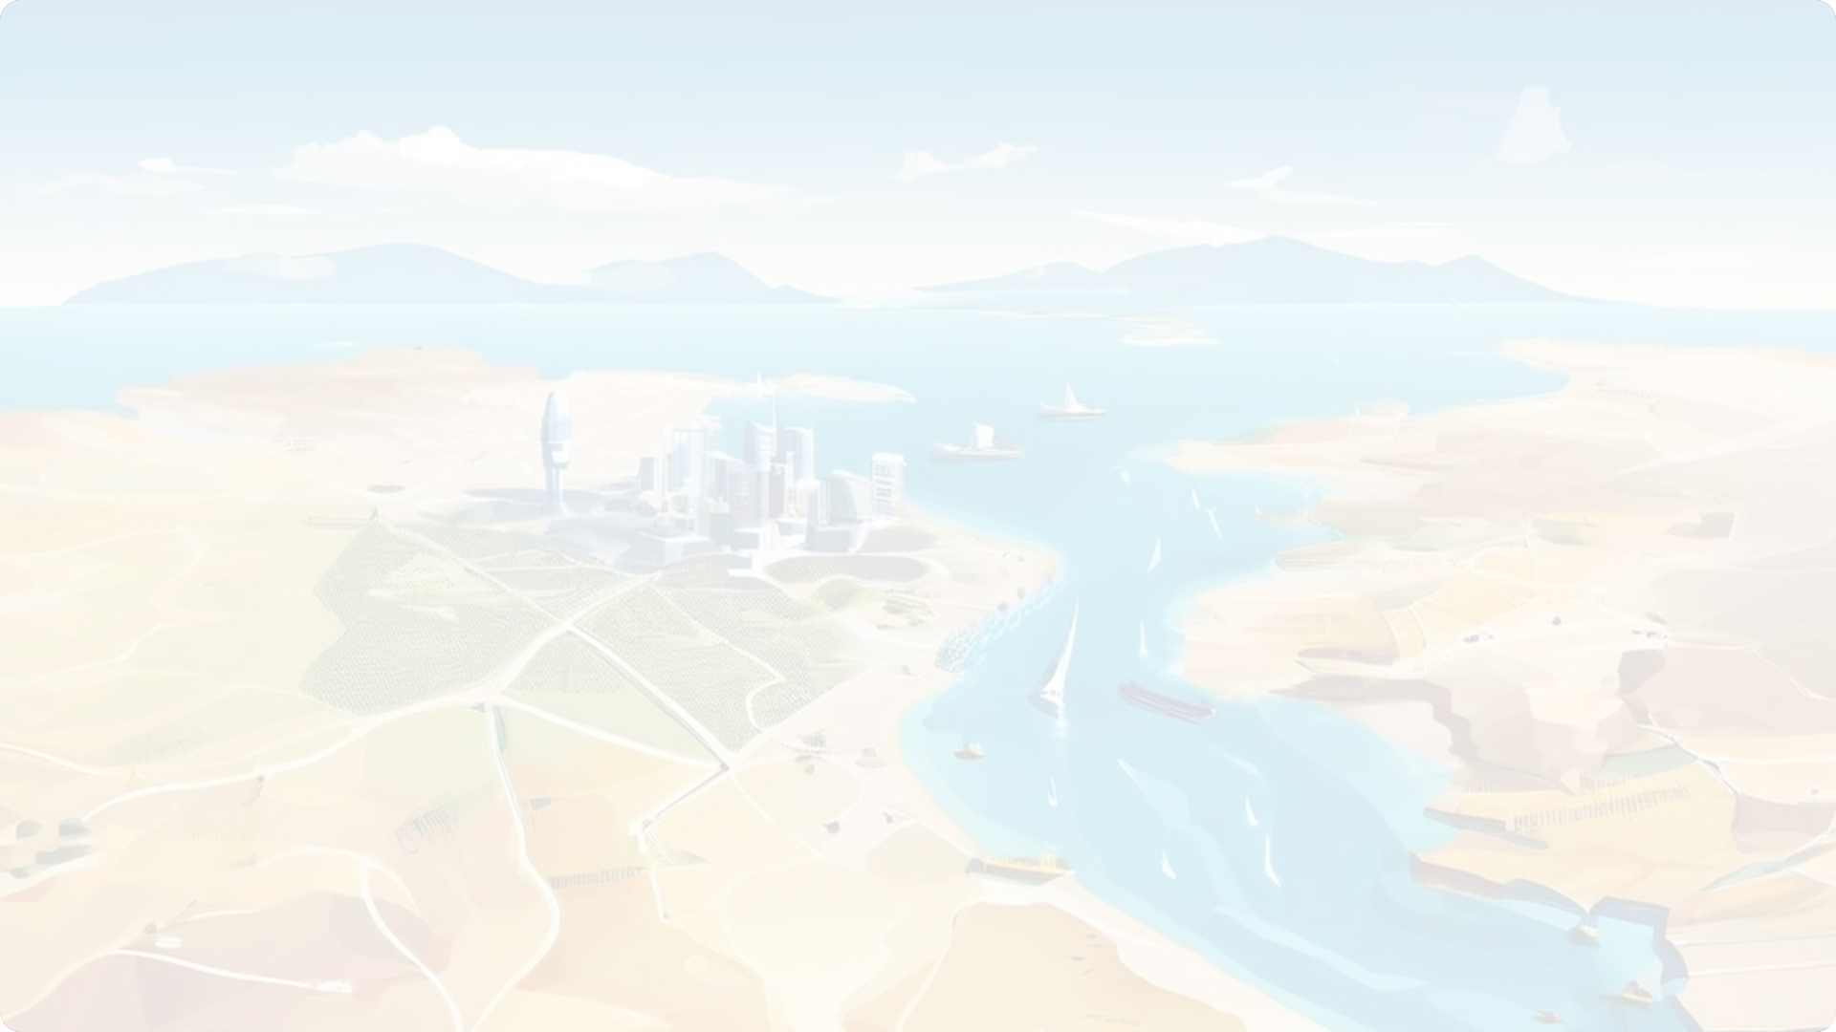
Russia's Expanding Influence in the Horn of Africa
Economic Interests
Russia seeks to capitalize on economic opportunities in the Horn of Africa.
Security Considerations
The Horn of Africa is a strategic location for security interests.
Geopolitical Goals
Russia aims to strengthen its geopolitical influence in the region.

